Slide 1

The Effect Of Various Census Demographics On Graduation Rates By County In NJ, NY, & PA
A presentation by: Areej, Isaac, Justin, Pavan &, Terry.

Slide 2
Project Description:
How do various different factors affect high school graduation rates in New Jersey, New York, and Pennsylvania.
Research Questions to Answer:
Does the poverty rate correlate to graduation rate?
Does household size correlate to graduation rate?
Does the unemployment rate correlate to graduation rate?
Does the median income correlate to graduation rate?
Does the language spoken at home affect graduation rates?

Slide 3
Data Sets to be Used:
American Community Survey - U.S. Census Bureau’s American Community Survey Office
Various State DOE Data Sets available on their state websites.

Slide 4
Project Outline:-
Our project begun with the three states where our data sample was collected. The following results were gathered.
Graduation rates by State
Poverty rate by State
Household size by State
Unemployment rate by State
Median income rate by State
Speak a language other than English by state
The Graduation rate data was sorted by County. We obtained different data sets from the Census for County level data.

Slide 5
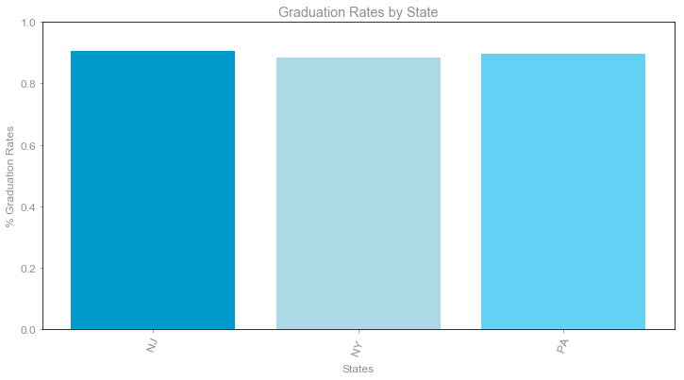

Slide 6
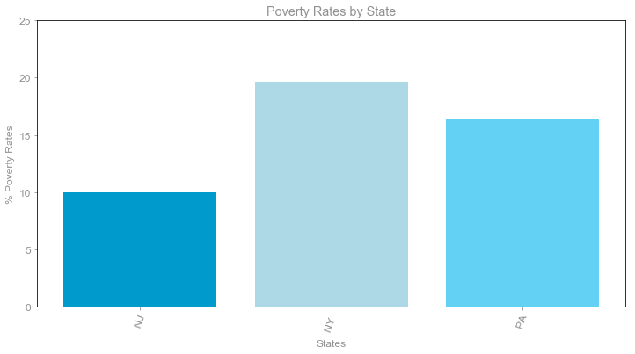

Slide 7
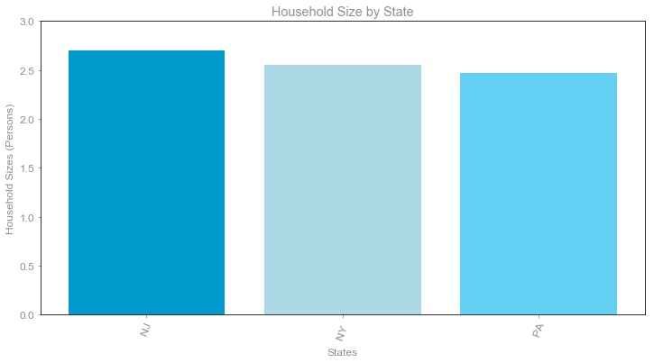

Slide 8
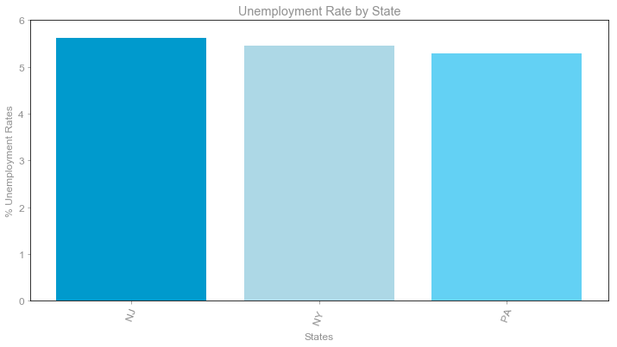

Slide 9
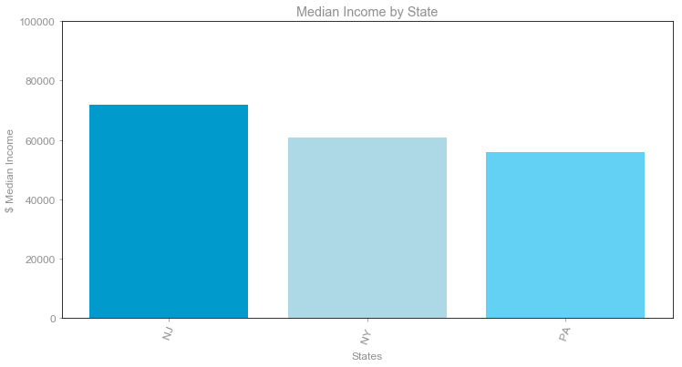

Slide 10
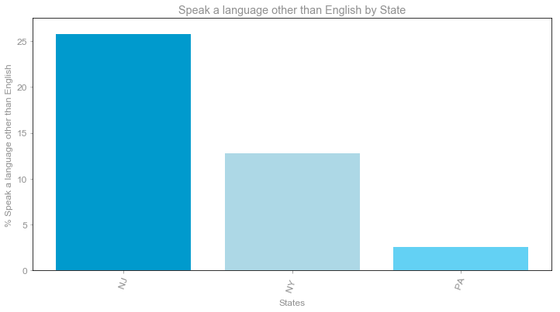

Slide 11
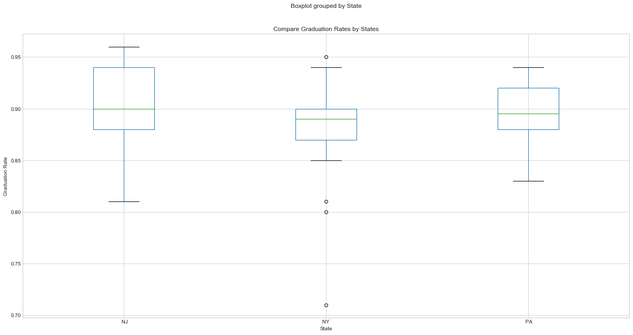

Slide 12
Noticeable Trends
Graduation rates, Household size, and Unemployment rates are very similar
New Jersey has the lowest poverty rate and New York has the highest poverty rate
Median income is higher in New Jersey
Speak a language other than English by state is higher in New Jersey
New Jersey has a higher median and a better over all graduation rate.

Slide 13
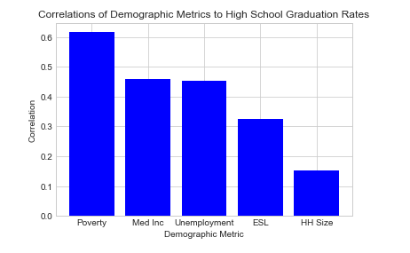

Slide 14
Graphs and Plots by County
Graduation rate by County
Poverty rate by County
Household size by County
Unemployment rate by County
Median income rate by County
Speak a language other than English by County

Slide 15
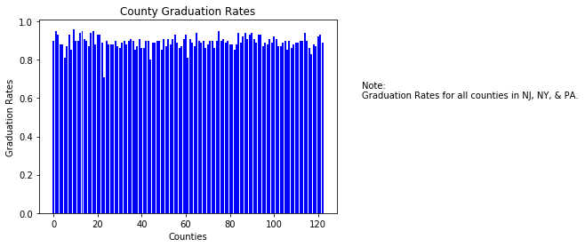

Slide 16
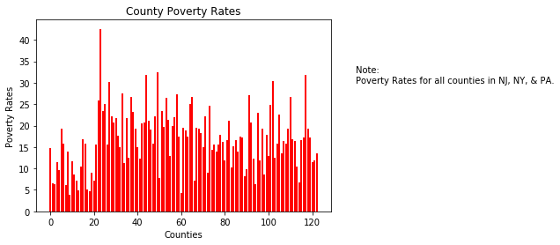

Slide 17
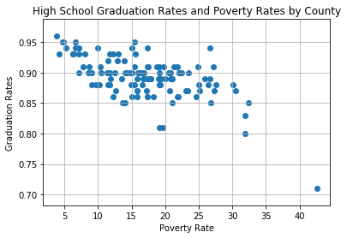

Slide 18
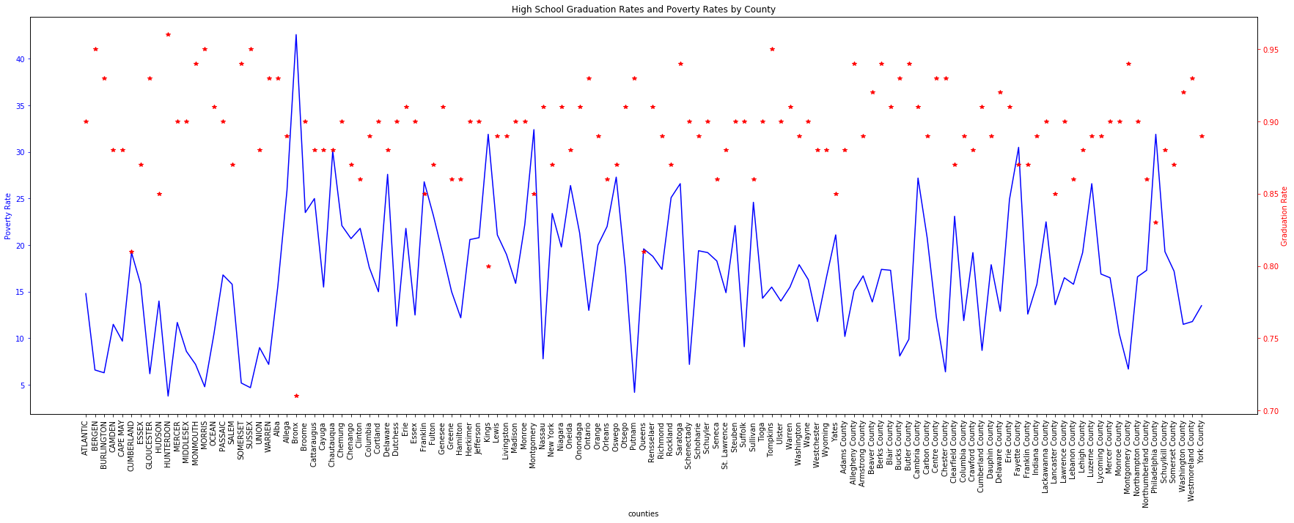

Slide 19
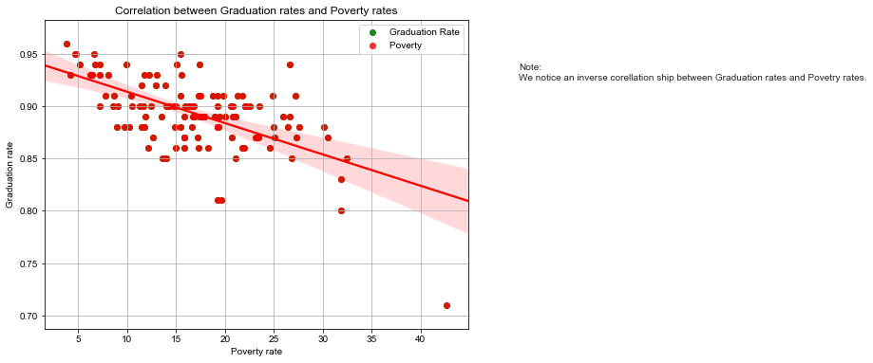

Slide 20
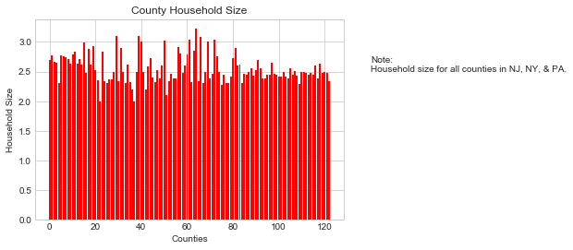

Slide 21
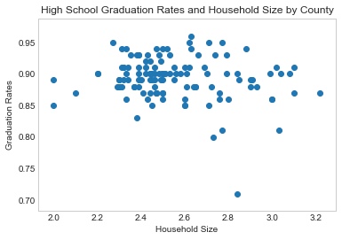

Slide 22
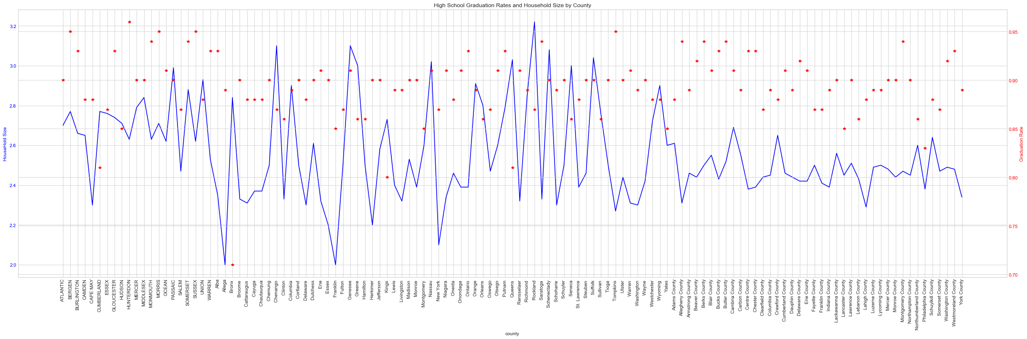

Slide 23
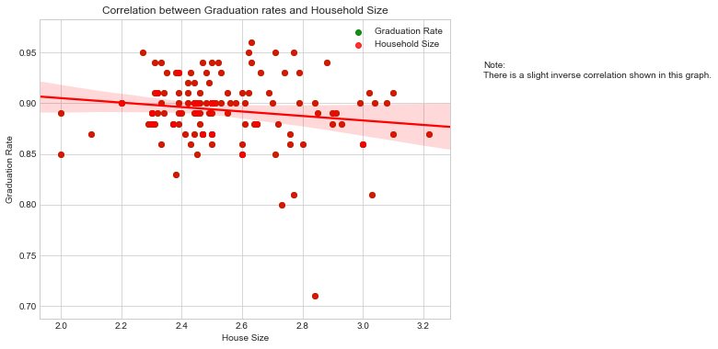

Slide 24
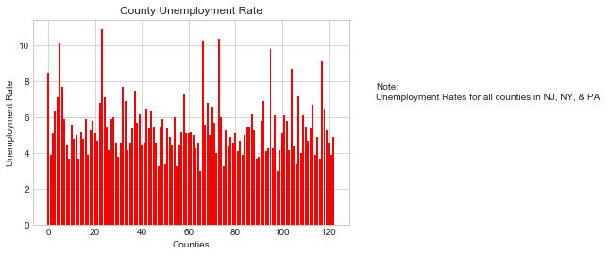

Slide 25
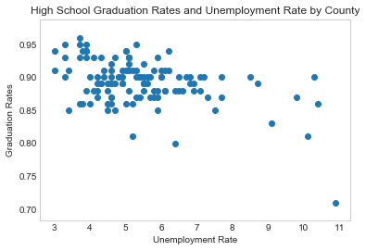

Slide 26
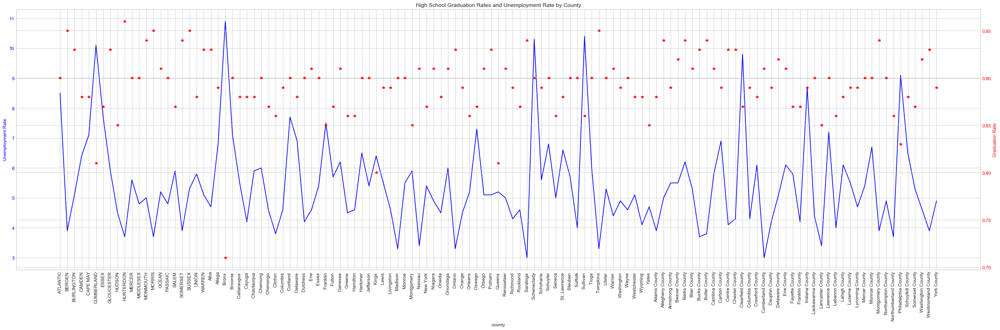

Slide 27
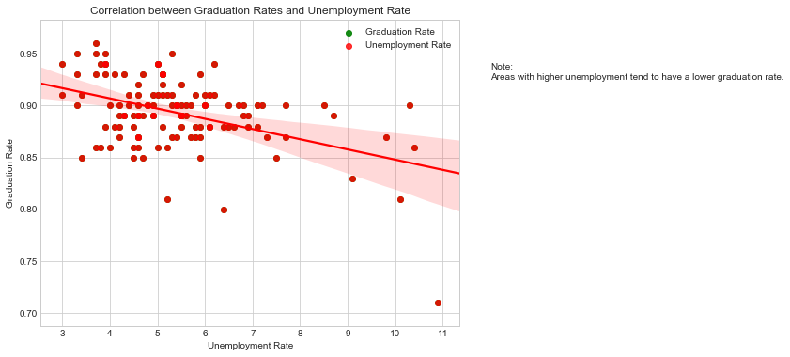

Slide 28
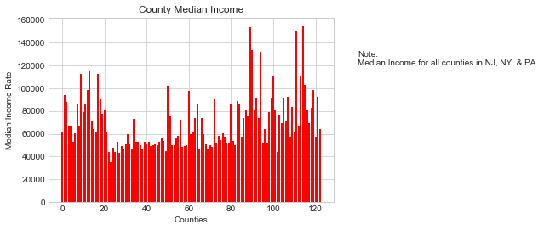

Slide 29
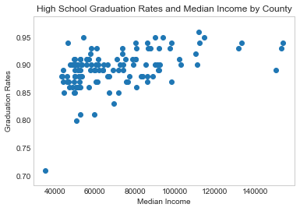

Slide 30
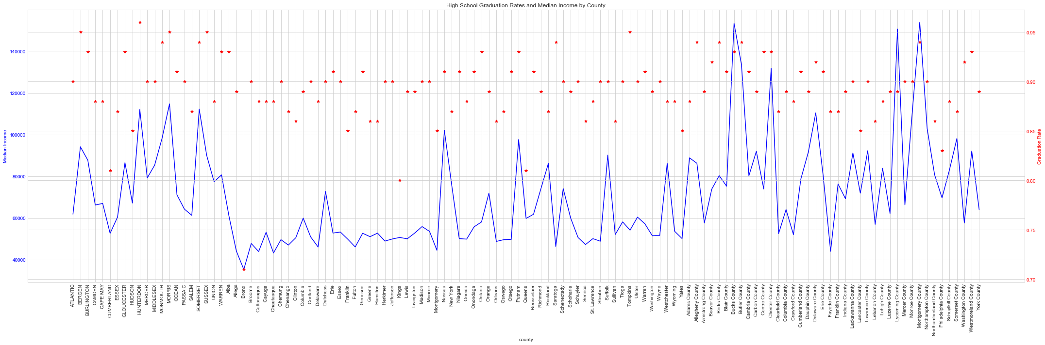

Slide 31
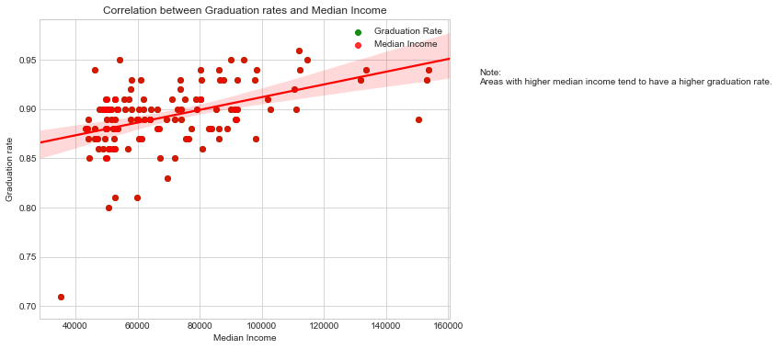

Slide 32
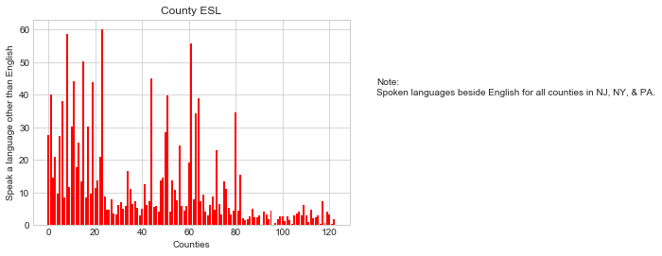

Slide 33
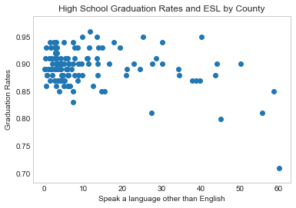

Slide 34
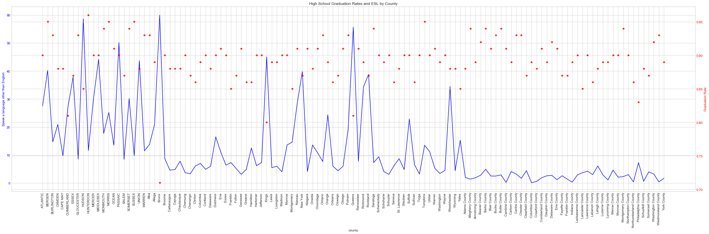

Slide 35
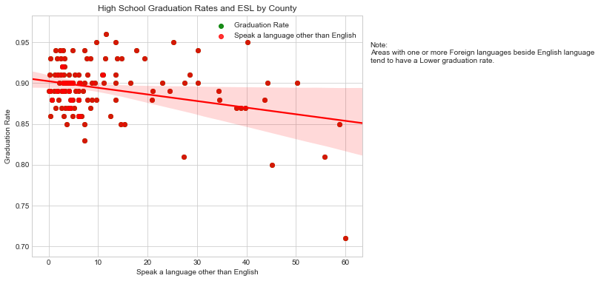

Slide 37
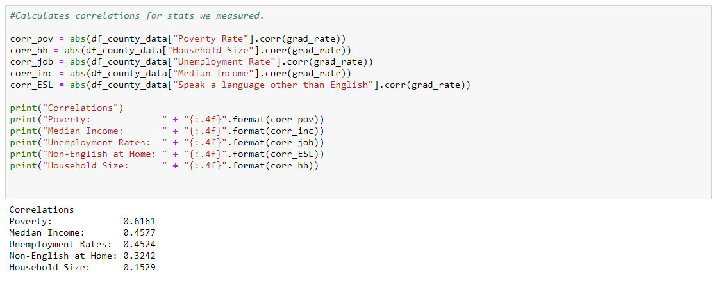
Conclusion:-
Overall the poverty rate had the strongest correlation to graduation rates in the various counties we analyzed. This is followed by median income, then the unemployment rate, the language spoken, and household size. Household size had an exceptionally low correlation.

